Slide 1
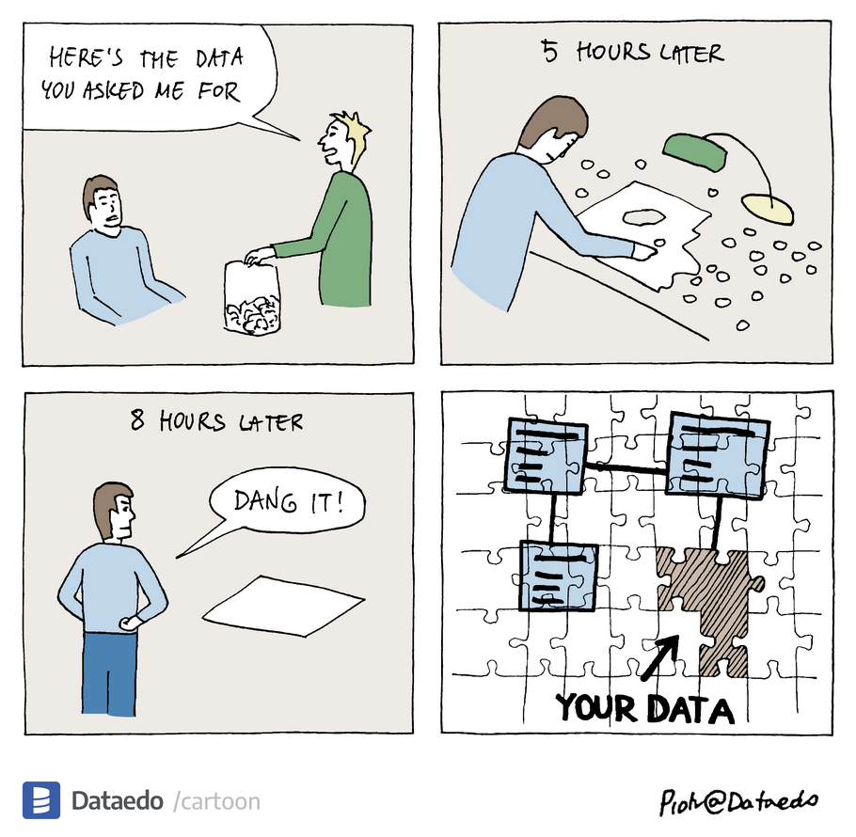
Missing data and multiple imputation
Melanoma research meeting June 28th 2022
Rik Verheijden, PhD candidate Department of Medical Oncology

Slide 2
Agenda
Why should we bother?
Types of missing data
Principles of multiple imputation
Practicalities
Step-by-step

Slide 3
Why should we bother?
ID | Sex | LDL (mmol/L) | BMI (kg/m²)
1 | M | 1.5 | 20.5
2 | M | 2.0 | 24.9
3 | M | 3.5 | 26.1
4 | F | 2.0 | 22.5
5 | F | 3.0 | 25.7
Decreased precision
Biased estimates
ID | Sex | LDL (mmol/L) | BMI (kg/m²)
1 | M | 1.5 | 20.5
2 | M | 2.0 | 24.9
3 | M | 3.5 | 26.1
4 | F | 2.0 | 22.5
5 | F | 3.0 | 25.7

Slide 4
Types of missing data
Missing Completely At Random (MCAR)
The probability that the observation of a given variable for a certain subject is missing is constant for all subjects
Missing At Random (MAR)
The probability that an observation is missing depends only on other observed values (patient characteristics and outcome)
Missing Not At Random (MNAR)
The probability that an observation is missing depends on unobserved values

Slide 5
Types of missing data
Random missing pattern
ID | Sex | LDL | BMI
1 | M | 1.5 | 20.5
2 | M | 2.0 | 24.9
3 | M | 3.5 | 26.1
4 | F | 2.0 | 22.5
5 | F | 3.0 | 25.7
Missing Completely At Random (MCAR)
The probability that the observation of a given variable for a certain subject is missing is constant for all subjects
Missing At Random (MAR)
The probability that an observation is missing depends only on other observed values (patient characteristics and outcome)
Missing Not At Random (MNAR)
The probability that an observation is missing depends on unobserved values
ID | Sex | LDL | BMI
1 | M | 1.5 | 20.5
2 | M | 2.0 | 24.9
3 | M | 3.5 | 26.1
4 | F | 2.0 | 22.5
5 | F | 3.0 | 25.7
Missing data only in males
ID | Sex | LDL | BMI
1 | M | 1.5 | 20.5
2 | M | 2.0 | 24.9
3 | M | 3.5 | 26.1
4 | F | 2.0 | 22.5
5 | F | 3.0 | 25.7
Missing data only in those with high LDL-cholesterol
(e.g. test was too far walking)

Slide 6
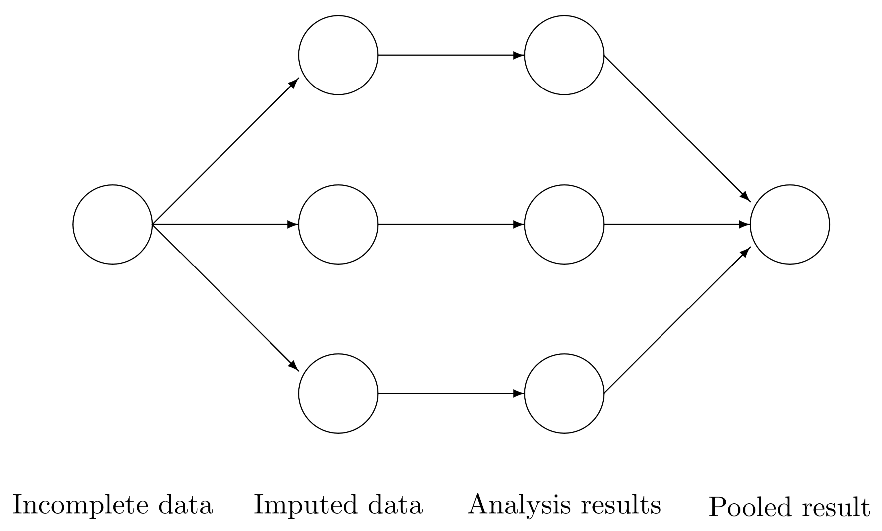
Principles of multiple imputation
Modified from: https://stefvanbuuren.name/fimd/workflow.html

Slide 7
Principles of multiple imputation
1 | F | 1.5 | 20.5
2 | M | 2.0 | 24.9
3 | M | 3.5 | 25.8
4 | F | 2.0 | 22.9
5 | F | 3.0 | 25.7
Analysis on 1st dataset
ID | Sex | LDL | BMI
1 | M | 1.5 | 20.5
2 | M | 2.0 | 24.9
3 | M | 3.5 | 26.1
4 | F | 2.0 | 22.5
5 | F | 3.0 | 25.7
1 | M | 1.5 | 20.5
2 | M | 2.0 | 24.9
3 | M | 3.5 | 27.2
4 | F | 2.0 | 23.1
5 | F | 3.0 | 25.7
Pooled result
Analysis on 2nd dataset
1 | M | 1.5 | 20.5
2 | M | 2.0 | 24.9
3 | F | 3.5 | 26.4
4 | F | 2.0 | 22.0
5 | F | 3.0 | 25.7
Analysis on 3rd dataset

Slide 8
Principles of multiple imputation
1 iteration
1 | F | 1.5 | 20.5
2 | M | 2.0 | 24.9
3 | M | 3.5 | 23.7
4 | F | 2.0 | 23.7
5 | F | 3.0 | 25.7
1 | F | 1.5 | 20.5
2 | M | 2.0 | 24.9
3 | M | 3.5 | 23.7
4 | F | 2.0 | 23.7
5 | F | 3.0 | 25.7
1 | F | 1.5 | 20.5
2 | M | 2.0 | 24.9
3 | M | 3.5 | 25.0
4 | F | 2.0 | 22.0
5 | F | 3.0 | 25.7
1 | F | 1.5 | 20.5
2 | M | 2.0 | 24.9
3 | M | 3.5 | 25.0
4 | F | 2.0 | 22.0
5 | F | 3.0 | 25.7
ID | Sex | LDL | BMI
1 | M | 1.5 | 20.5
2 | M | 2.0 | 24.9
3 | M | 3.5 | 26.1
4 | F | 2.0 | 22.5
5 | F | 3.0 | 25.7
1 | F | 1.5 | 20.5
2 | M | 2.0 | 24.9
3 | M | 3.5 | 23.7
4 | F | 2.0 | 23.7
5 | F | 3.0 | 25.7
1 | F | 1.5 | 20.5
2 | M | 2.0 | 24.9
3 | M | 3.5 | 23.7
4 | F | 2.0 | 23.7
5 | F | 3.0 | 25.7
1 | F | 1.5 | 20.5
2 | M | 2.0 | 24.9
3 | M | 3.5 | 28.8
4 | F | 2.0 | 21.9
5 | F | 3.0 | 25.7
1 | M | 1.5 | 20.5
2 | M | 2.0 | 24.9
3 | M | 3.5 | 28.8
4 | F | 2.0 | 21.9
5 | F | 3.0 | 25.7
1 | M | 1.5 | 20.5
2 | M | 2.0 | 24.9
3 | M | 3.5 | 23.7
4 | F | 2.0 | 23.7
5 | F | 3.0 | 25.7
1 | M | 1.5 | 20.5
2 | M | 2.0 | 24.9
3 | F | 3.5 | 23.7
4 | F | 2.0 | 23.7
5 | F | 3.0 | 25.7
1 | M | 1.5 | 20.5
2 | M | 2.0 | 24.9
3 | F | 3.5 | 25.6
4 | F | 2.0 | 22.4
5 | F | 3.0 | 25.7
1 | M | 1.5 | 20.5
2 | M | 2.0 | 24.9
3 | F | 3.5 | 25.6
4 | F | 2.0 | 22.4
5 | F | 3.0 | 25.7

Slide 9
Principles of multiple imputation
1st iteration
2nd iteration
1 | F | 1.5 | 20.5
2 | M | 2.0 | 24.9
3 | M | 3.5 | 23.7
4 | F | 2.0 | 23.7
5 | F | 3.0 | 25.7
1 | F | 1.5 | 20.5
2 | M | 2.0 | 24.9
3 | M | 3.5 | 25.0
4 | F | 2.0 | 22.0
5 | F | 3.0 | 25.7
1 | F | 1.5 | 20.5
2 | M | 2.0 | 24.9
3 | M | 3.5 | 25.0
4 | F | 2.0 | 22.0
5 | F | 3.0 | 25.7
1 | F | 1.5 | 20.5
2 | M | 2.0 | 24.9
3 | M | 3.5 | 25.6
4 | F | 2.0 | 23.0
5 | F | 3.0 | 25.7
1 | F | 1.5 | 20.5
2 | M | 2.0 | 24.9
3 | M | 3.5 | 25.8
4 | F | 2.0 | 22.9
5 | F | 3.0 | 25.7
Analysis on 1st dataset
1 | F | 1.5 | 20.5
2 | M | 2.0 | 24.9
3 | M | 3.5 | 23.7
4 | F | 2.0 | 23.7
5 | F | 3.0 | 25.7
1 | F | 1.5 | 20.5
2 | M | 2.0 | 24.9
3 | M | 3.5 | 28.8
4 | F | 2.0 | 21.9
5 | F | 3.0 | 25.7
1 | M | 1.5 | 20.5
2 | M | 2.0 | 24.9
3 | M | 3.5 | 28.8
4 | F | 2.0 | 21.9
5 | F | 3.0 | 25.7
1 | F | 1.5 | 20.5
2 | M | 2.0 | 24.9
3 | M | 3.5 | 27.4
4 | F | 2.0 | 23.0
5 | F | 3.0 | 25.7
1 | M | 1.5 | 20.5
2 | M | 2.0 | 24.9
3 | M | 3.5 | 27.2
4 | F | 2.0 | 23.1
5 | F | 3.0 | 25.7
Analysis on 2nd dataset
1 | M | 1.5 | 20.5
2 | M | 2.0 | 24.9
3 | F | 3.5 | 23.7
4 | F | 2.0 | 23.7
5 | F | 3.0 | 25.7
1 | M | 1.5 | 20.5
2 | M | 2.0 | 24.9
3 | F | 3.5 | 25.6
4 | F | 2.0 | 22.4
5 | F | 3.0 | 25.7
1 | M | 1.5 | 20.5
2 | M | 2.0 | 24.9
3 | F | 3.5 | 25.6
4 | F | 2.0 | 22.4
5 | F | 3.0 | 25.7
1 | M | 1.5 | 20.5
2 | M | 2.0 | 24.9
3 | F | 3.5 | 26.3
4 | F | 2.0 | 22.0
5 | F | 3.0 | 25.7
1 | M | 1.5 | 20.5
2 | M | 2.0 | 24.9
3 | F | 3.5 | 26.4
4 | F | 2.0 | 22.0
5 | F | 3.0 | 25.7
Analysis on 3rd dataset

Slide 10
Principles of multiple imputation
1 | F | 1.5 | 20.5
2 | M | 2.0 | 24.9
3 | M | 3.5 | 25.6
4 | F | 2.0 | 23.0
5 | F | 3.0 | 25.7
1 | F | 1.5 | 20.5
2 | M | 2.0 | 24.9
3 | M | 3.5 | 25.8
4 | F | 2.0 | 22.9
5 | F | 3.0 | 25.7
Analysis on 1st dataset
1 | F | 1.5 | 20.5
2 | M | 2.0 | 24.9
3 | M | 3.5 | 27.4
4 | F | 2.0 | 23.0
5 | F | 3.0 | 25.7
1 | M | 1.5 | 20.5
2 | M | 2.0 | 24.9
3 | M | 3.5 | 27.2
4 | F | 2.0 | 23.1
5 | F | 3.0 | 25.7
Pooled result
Analysis on 2nd dataset
1 | M | 1.5 | 20.5
2 | M | 2.0 | 24.9
3 | F | 3.5 | 26.3
4 | F | 2.0 | 22.0
5 | F | 3.0 | 25.7
1 | M | 1.5 | 20.5
2 | M | 2.0 | 24.9
3 | F | 3.5 | 26.4
4 | F | 2.0 | 22.0
5 | F | 3.0 | 25.7
Analysis on 3rd dataset

Slide 11
Principles of multiple imputation
Rubin’s rules
Number of iterations (maxit/numit)
Number of imputations (m)
Modified from: https://stefvanbuuren.name/fimd/workflow.html

Slide 12
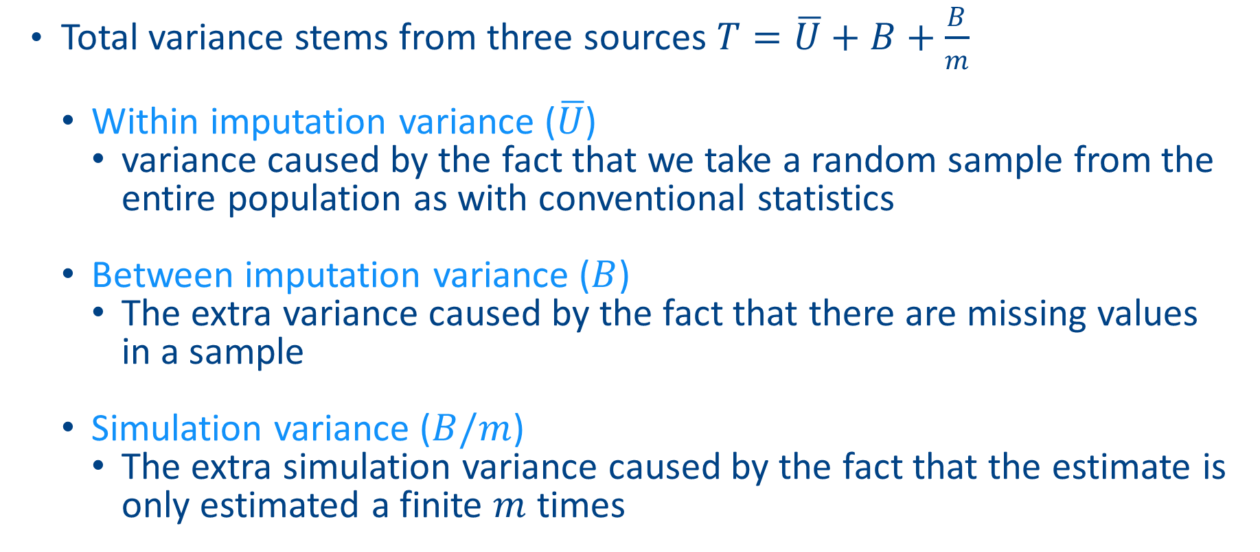
Rubin’s rules: estimating variance
Total variance stems from three sources $T=\overline{U}+B+\frac{B}{m}$
Within imputation variance ($\overline{U}$)
variance caused by the fact that we take a random sample from the entire population as with conventional statistics
Between imputation variance ($B$)
The extra variance caused by the fact that there are missing values in a sample
Simulation variance ($B/m$)
The extra simulation variance caused by the fact that the estimate is only estimated a finite $m$ times

Slide 13
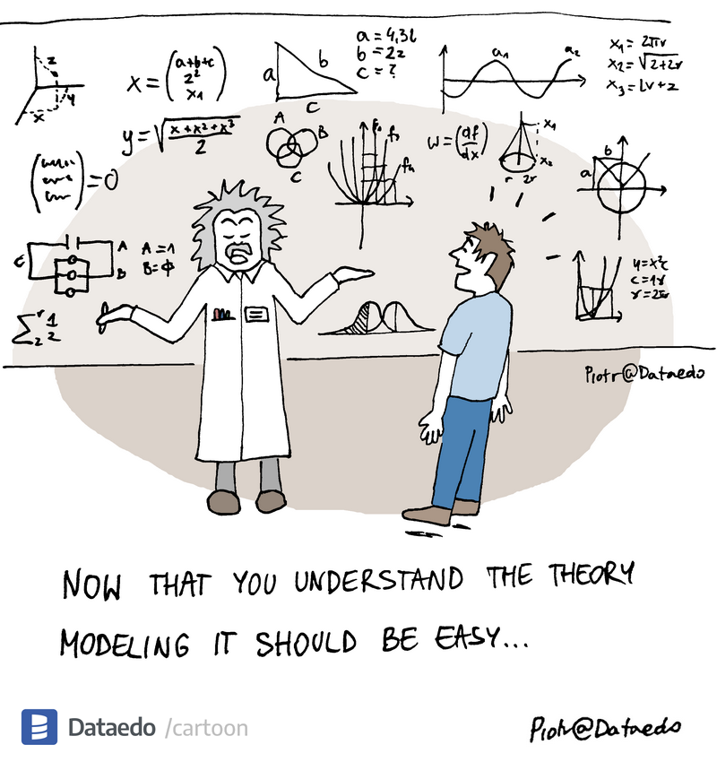
Practicalities
Compatibility
Derived variables
Predictor matrix
Methods
Don’t forget

Slide 14
Practicalities: compatibility
The imputation model should correspond the analysis (compatibility/congeniality) and shoud thus include:
Outcome variable (but exclude cases with missing outcome from analysis)
Covariates/confounders
Interactions
Transformations/non-linear effects
Auxiliary variables are allowed

Slide 15
Practicalities: derived variables
ID | Sex | LDL (mmol/L) | Weight (kg) | Length (m) | BMI (kg/m²)
1 | M | 1.5 | 70 | 1.85 | 20.5
2 | M | 2.0 | 90 | 1.90 | 24.9
3 | M | 3.5 | 80 | 1.75 | 26.1
4 | F | 2.0 | 65 | 1.70 | 22.5
5 | F | 3.0 | 70 | 1.65 | 25.7
Passive imputation
Just-another-variable
Impute-then-transform
Discard variables from which they are derived (weight and length)
Modified from: https://stefvanbuuren.name/fimd/workflow.html

Slide 16
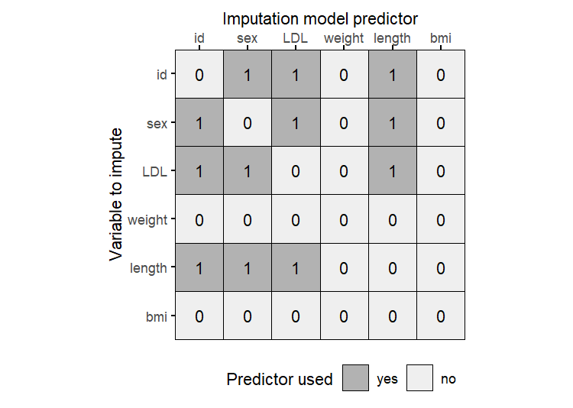
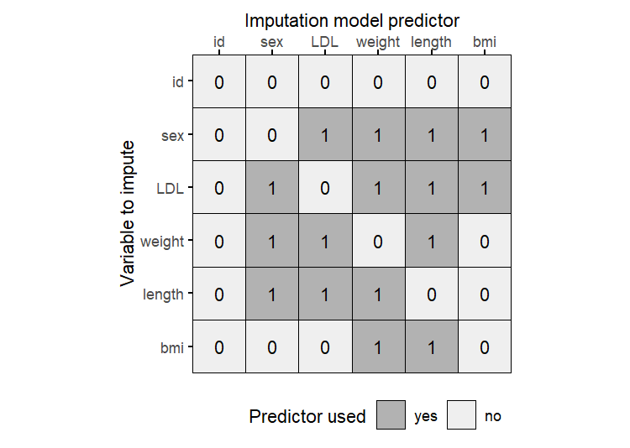
Practicalities: predictor matrix
ID | Sex | LDL (mmol/L) | Weight (kg) | Length (m) | BMI (kg/m²)
1 | M | 1.5 | 70 | 1.85 | 20.5
2 | M | 2.0 | 90 | 1.90 | 24.9
3 | M | 3.5 | 80 | 1.75 | 26.1
4 | F | 2.0 | 65 | 1.70 | 22.5
5 | F | 3.0 | 70 | 1.65 | 25.7

Slide 17
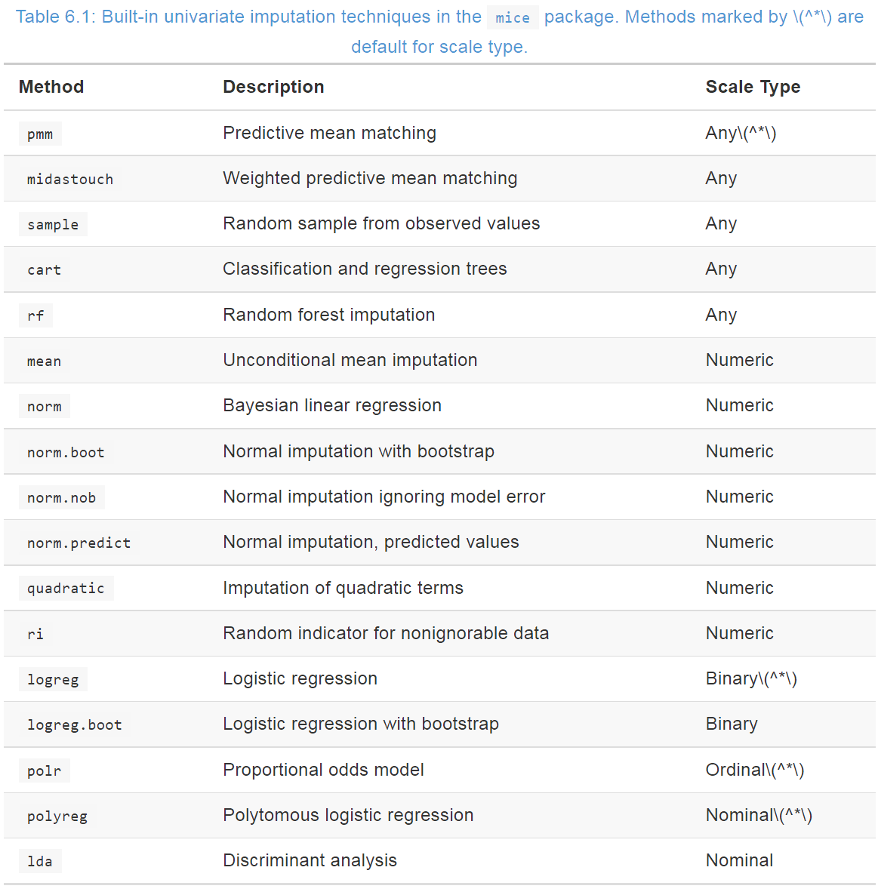
Practicalities: methods
method[“bmi”]<-
”I(weight/(length^2))”
https://stefvanbuuren.name/fimd/workflow.html

Slide 18
Practicalities: imputation step-by-step
Load data
Inspect missingness
Percentage of missingness
Compare complete cases with cases with ≥1 missing
Missingness pattern+correlation
Think what and how to impute
Prepare for imputation
Select variables
Transform variables
Run dry imputation
Modify methods
Modify predictor matrix
Actual imputation
Check imputation
Check convergence
Check imputed vs observed
Modify imputed dataset if necessary
Analysis of all imputed datasets and pooling of results
Passive imputation
Impute-then-transform

Slide 19
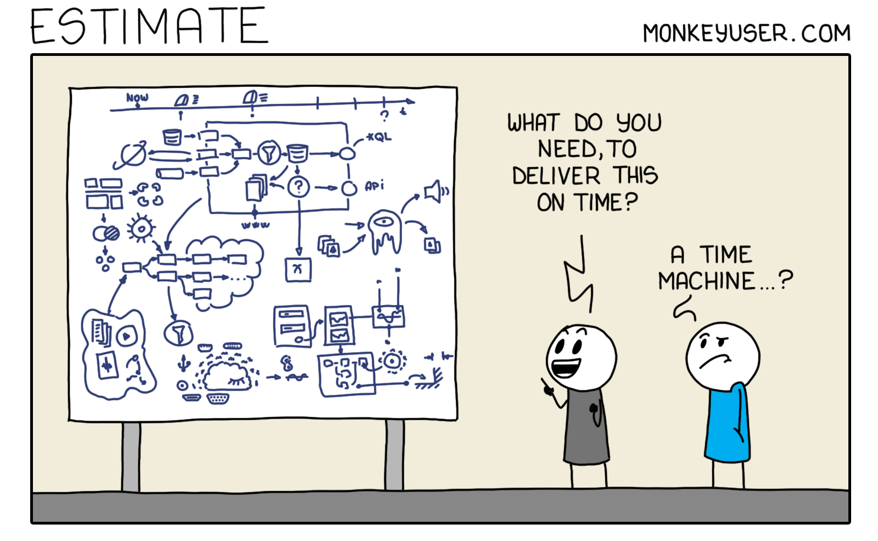
Questions?

